Slide 1
Power house management system

Slide 2

Power house management:
The Power Management System (PMS) is often provided as part of the IAS and provides control of electrical generators, switchboards and large consumers. The primary function of the Power Management System is to ensure that power capacity is in line with vessel power demand at any time.

Slide 3
SCOPE OF WORK:-
OUR PROJECT AIMS AT BUSINESS PROCESS AUTOMATION, I.E. WE HAVE TRIED TO COMPUTERIZE VARIOUS PROCESSES OF POWER HOUSE MANAGEMENT SYSTEM. IN THE SECTOR OF ELECTRICITY BOARD WE HAVE COMPUTERIZES THEIR DEPARTMENT AND STOCK MAINTENANCE.
SCOPE OF ANY SOFTWARE DEPENDS UPON THE FOLLOWING THINGS:
1. IT SATISFY THE USER REQUIREMENT
2. BE EASY TO UNDERSTAND BY THE USER AND OPERATOR
3. BE EASY TO OPERATE
4. HAVE A GOOD USER INTERFACE
5. BE EXPANDABLE
6. DELIVERED ON SCHEDULE WITHIN THE BUDGET. WE HAVE TRIED TO MAKE SUCH TYPE OF SOFTWARE, WHICH SATISFY THE ABOVE GIVEN REQUIREMENT.

Slide 4
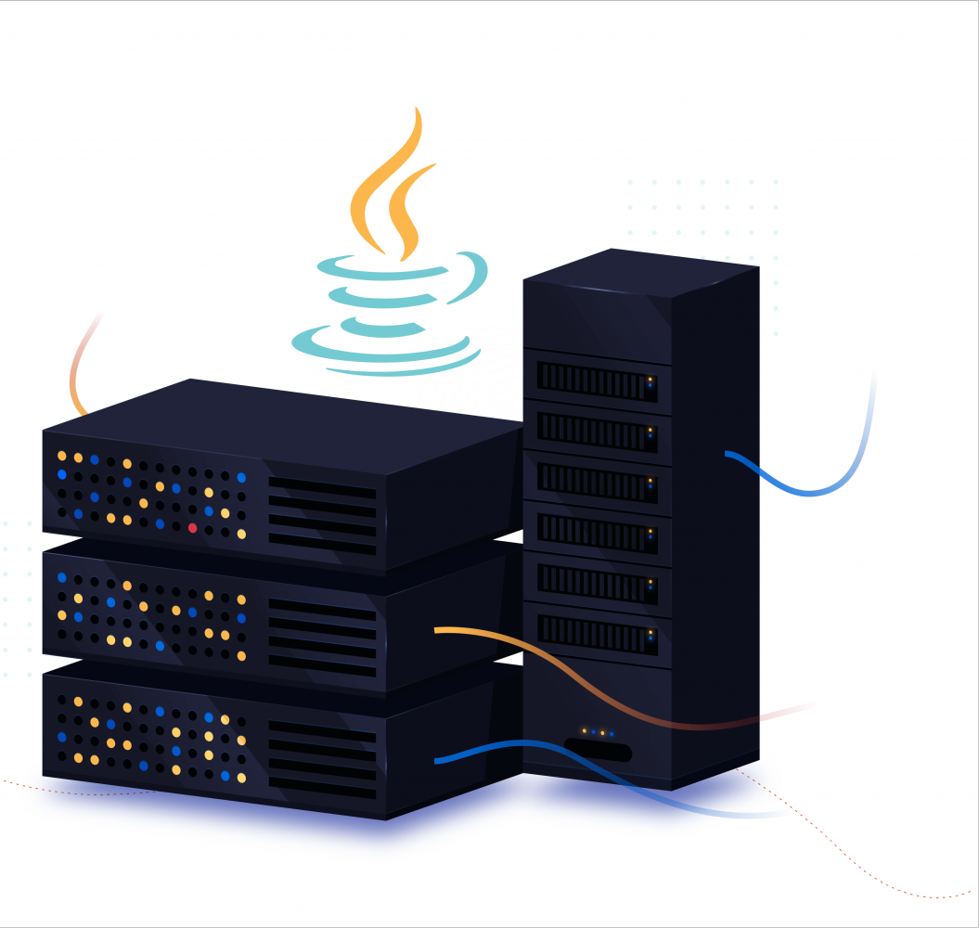
Functional Requirements
High-level overview of the architecture
Introduction:
Title: High-Level Architecture of Java Power House Management System
Objective: Provide an overview of the system architecture and its components.

Slide 5
Components of the System
1. Frontend
Description: The user interface component that interacts directly with users.
Technologies:
  HTML, CSS, JavaScript for UI development.
  Possibly a frontend framework like Angular, React, or Vue.js for enhanced interactivity and user experience.

Slide 6
2. Backend
Description: Handles business logic, data processing, and communication with other systems.
Technologies:
  Java: Core programming language for backend development.
  Java EE (Enterprise Edition): Provides standard APIs and features for enterprise applications.
    Servlets and JSP (JavaServer Pages) for handling HTTP requests and generating dynamic web content.
    Enterprise JavaBeans (EJB) for modular components.
    Java Message Service (JMS) for asynchronous messaging.
  Spring Framework: Adds modularity and simplifies development.
    Spring Boot for rapid application development.
    Spring MVC (Model-View-Controller) for building RESTful APIs.
    Spring Security for authentication and authorization.

Slide 7
Key Features
- Real-time Monitoring and Control
Description: Provides real-time updates on power generation, consumption, and operational status.
Technologies:
  WebSocket for real-time communication between frontend and backend.
  Dashboard visualization for monitoring critical metrics.
- Analytics and Reporting
Description: Analyzes historical data for performance optimization and decision-making.

Slide 8
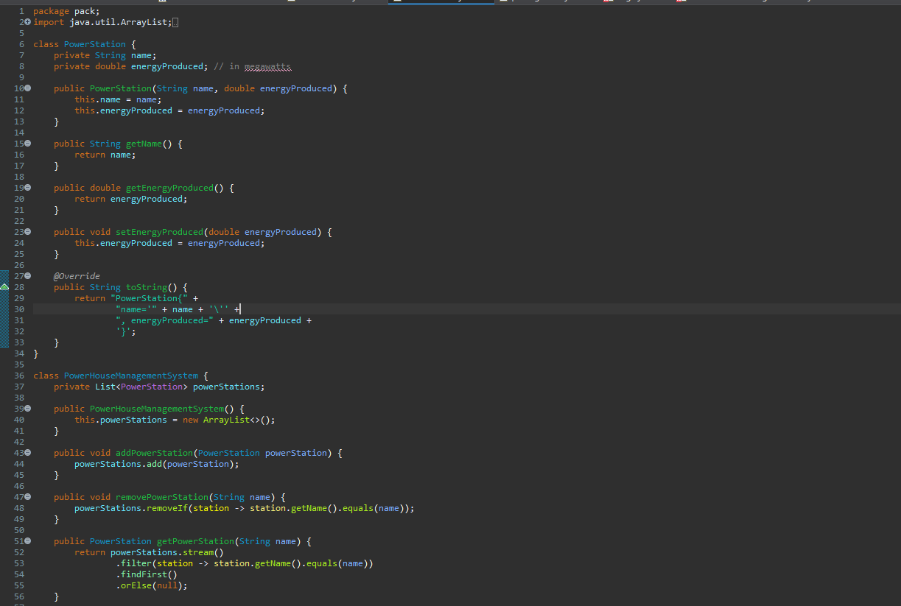
JAVA CODE :-

Slide 9
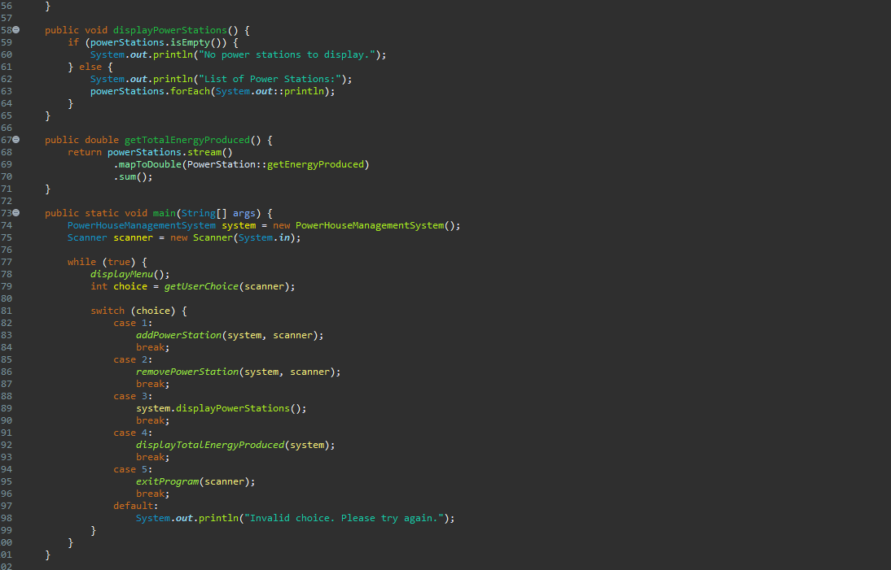

Slide 10
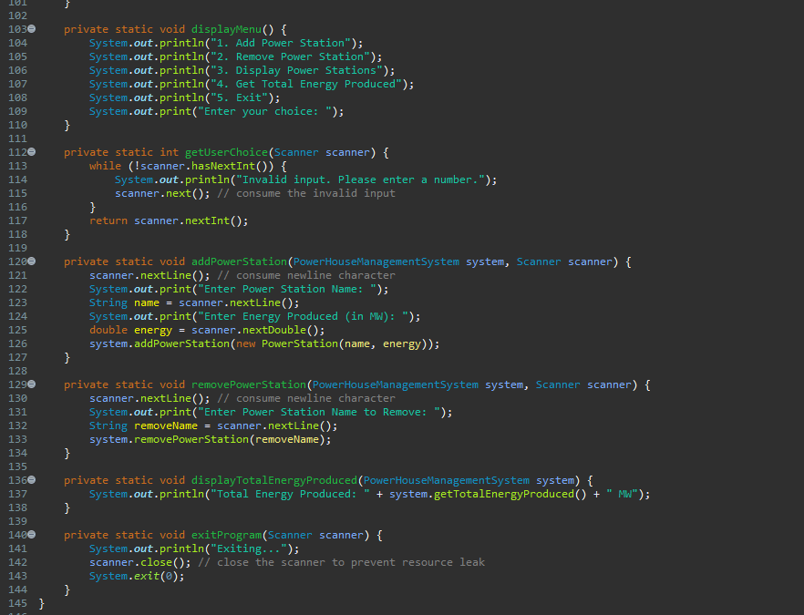

Slide 11
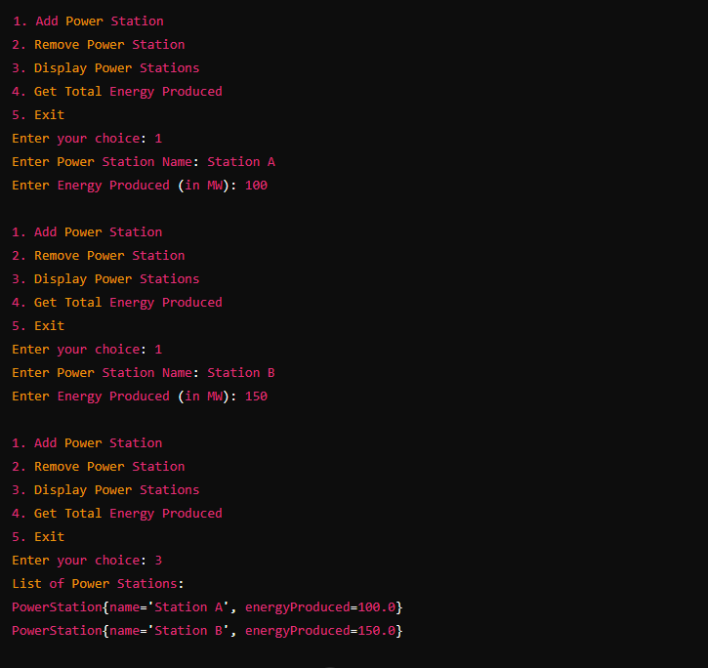
Output :-

Slide 12
Program Explanation:
Classes
        PowerStation: Represents a power station with attributes - name and energyProduced.
        PowerHouseManagementSystem: Manages a list of PowerStation objects and provides methods to add, remove, display, and calculate energy produced.
Main Method
      Creates an instance of PowerHouseManagementSystem
      Uses a Scanner object to interact with user inputs.
      Displays a menu repeatedly until the user chooses to exit (choice 5).

Slide 13
Menu Options:
        1. Add Power Station: Prompts for station name and energy produced, then adds
        it to the system.
        2. Remove Power Station: Prompts for station name to remove it from the system.
        3. Display Power Stations: Shows a list of all current power stations.
        4. Get Total Energy Produced: Calculates and displays the total energy produced
        by all stations.
        5. Exit: Terminates the program.
Input Handling:
      1.Uses Scanner to read user inputs for menu choices and station details.
      2.Validates input to ensure integers are entered for menu choices and
      handles mismatch exceptions.

Slide 14
Object-Oriented Concepts Demonstrated:
Classes and Objects:
Class Definition: Both PowerStation and PowerHouseManagementSystem
are classes.
Object Creation: Instances of PowerStation (representing individual
power stations) and PowerHouseManagementSystem (managing a list
of power stations) are created and manipulated.
Encapsulation:
Private Fields and Public Methods:
  In PowerStation: name and energyProduced are private fields accessed
  via public getter (getName(), getEnergyProduced()) and setter
  (setEnergyProduced()) methods.
  In PowerHouseManagementSystem: powerStations is a private list
  of PowerStation objects, and methods like addPowerStation(), removePowerStation(), getPowerStation(), displayPowerStations(), and getTotalEnergyProduced() provide controlled access to this list.

Slide 15
Main Method:
  public static void main(String[] args): Entry point of the application, executed in a static context.
  Static methods like displayMenu(), getUserChoice(), addPowerStation(), removePowerStation(), displayTotalEnergyProduced(), and exitProgram() are used within main().
Exception Handling:
    Input Validation:
    getUserChoice(Scanner scanner): Ensures that user input is an integer; otherwise, it prompts the user to enter a valid number.
Control Structures:
      Looping (while loop):
        while (true) { ... } in main(): Creates a loop that continuously displays the menu and processes user input until the user chooses to exit.

Slide 16
Thank You !..

